Slide 1
Bayer's Digital Experience
Digital Label , Web-App for customers , Logistics Tracking and analytics
Team : Akira

Slide 2
Target Customer
This project is more focused on attracting new (younger) customers while improving the trust and experience of existing (experienced) customers.
Smartphone(with camera) or computer with camera is required.
The objective of the project is to make the farmer use the app on a regular basis and not as a one time verification process.
The app is designed to be dynamic, interactive and customer engaging

Slide 3
Objective
For Customer
Make the labels look modern with integration of simple to scan QR code
QR code => embedding a unique url (similar to serial number) - which can ensure the authenticity / logistics tracking of the product.
QR code => for getting more details about product
QR code => for product warranty (ensuring authenticity of the product)
Mobile App / website => Digital support, instruction and notifications
Mobile App / website => New product, expiry and offers notifications
Mobile App / website => Auto translation based on country
Mobile App / website => Chatbot assist and feedback ( sentiment analysis )
For Company
website dashboard => Track shipping data (logistics)
website dashboard => Track authenticity data (when seller / marketer/ customer scans the product )
website dashboard => Product discussion tracking for feedback. (captured from mobile app)

Slide 4
Architecture / Data Flow
Bayer’s Production Plant
Marketing Partners
(Logistics, Marketing and Sellers)
Customers / End User
WebApp 1 : (For Bayer employee)
Bayer Farm Product with unique QR code per item
full - owner
Adds to DB
WebApp 2 : (For partners)
Scans the QR code on departure and arrival
new partial owner
Updates DB
WebApp 3 : (For Customers)
Scans the QR code
full - owner
Updates DB end of ownership
---------------------------------------------
Screens and features
More Info on the product
Days left for expiry , Usage instruction
Chatbot and discussion/feedback
Translator
Backend - ( NodeJS, Express)
Managers/ Leadership
Validations / Authenticity validator
Database
WebApp 1 : (For Bayer employee)
logistics analytics and prediction product usage analytics feedback sentiment analysis

Slide 5
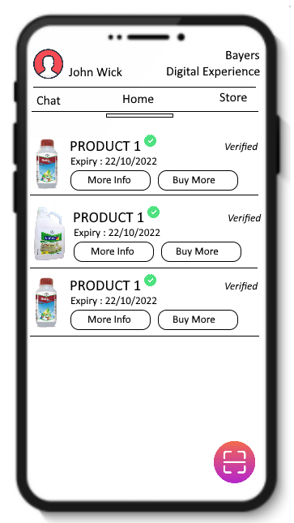
Sample UI design for End User -
Get information of the products the customer is using
Content. Days left for expiry , Usage instruction with different crops, Storage / Safety instructions
Translator will be available ( using google translate) based on location
Chatbot - talk to the app to get required information => for older people who are not much familiar with mobiles
Notification - almost time for expiry , time to refill / order new , new offers , new products
Discussion section - to ask questions about the product.

Slide 6
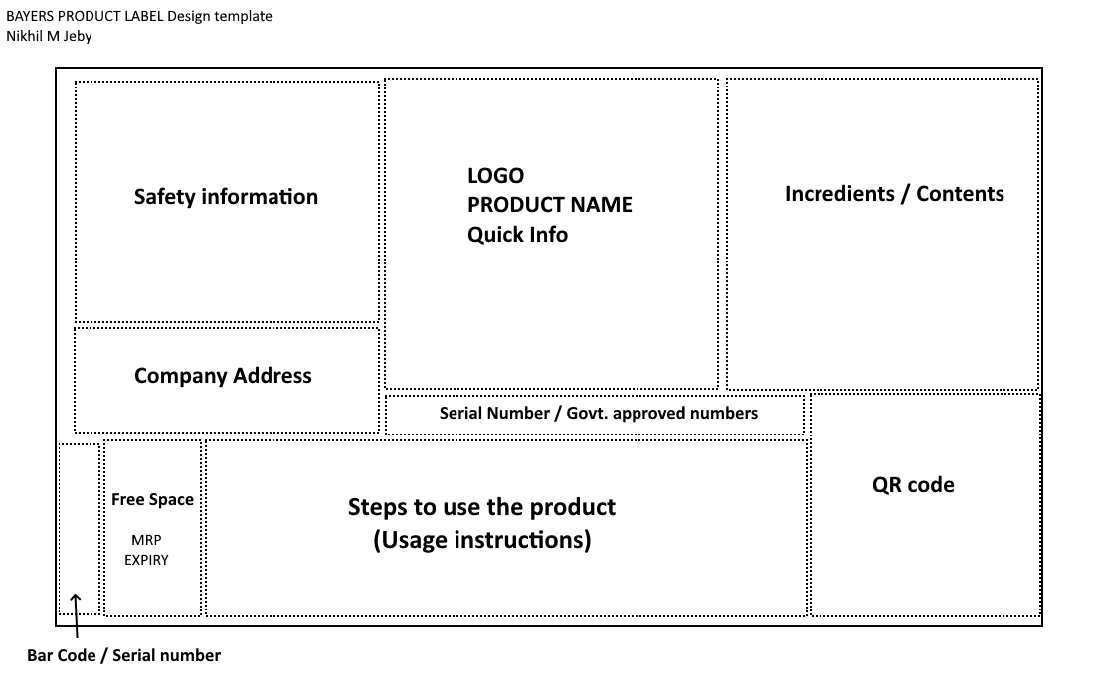
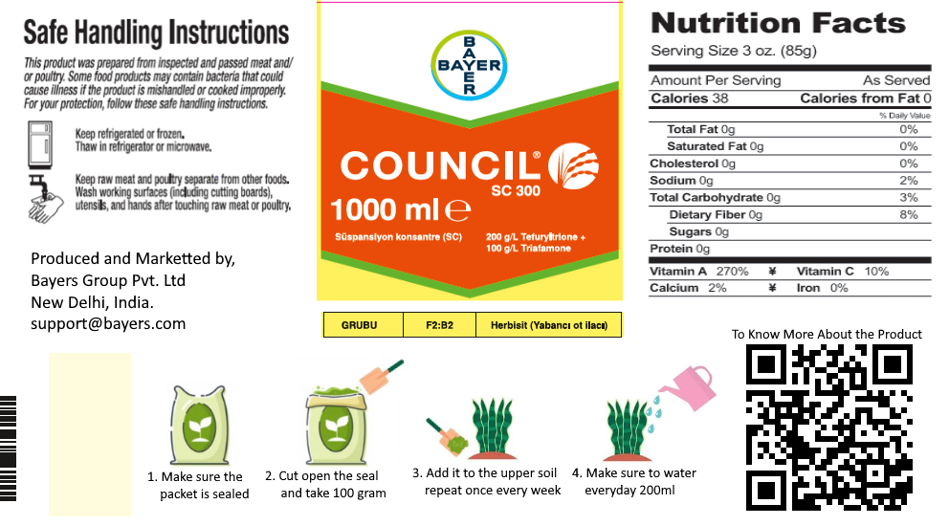
Sample Label Design -

